Slide 1
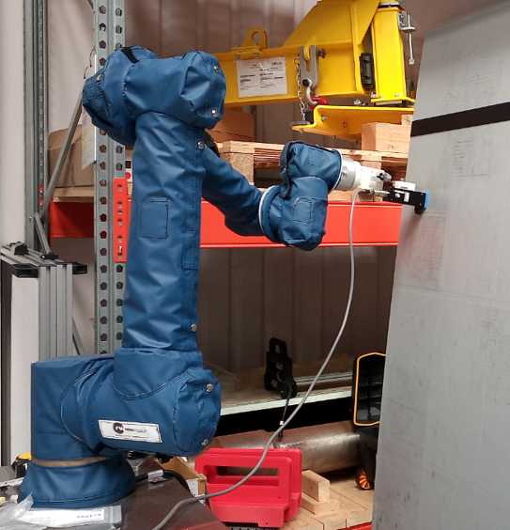
TAP TESTING:
From tradition to automation

Slide 2
What is Tap Testing?
Hammer
Tap Testing is an inspection method that infers a material’s condition from its change in force and sound when physically struck
Defects within the material are found by comparing their physical rebounds and echoes to those of a known good area
Two most common products for acceleration tap testing:
  WichiTech RD³
  Mitsui “Woodpecker”
GFRP Air foil
Resin
Resin
Spar
Hammer
GFRP Air foil
Resin
Resin
Spar

Slide 3
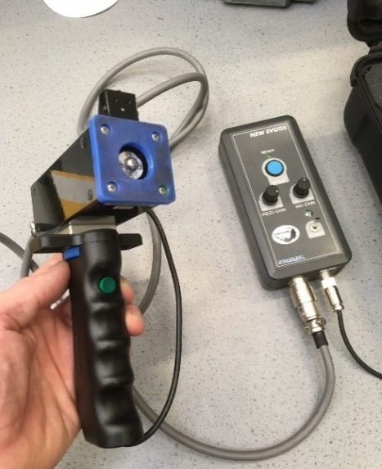
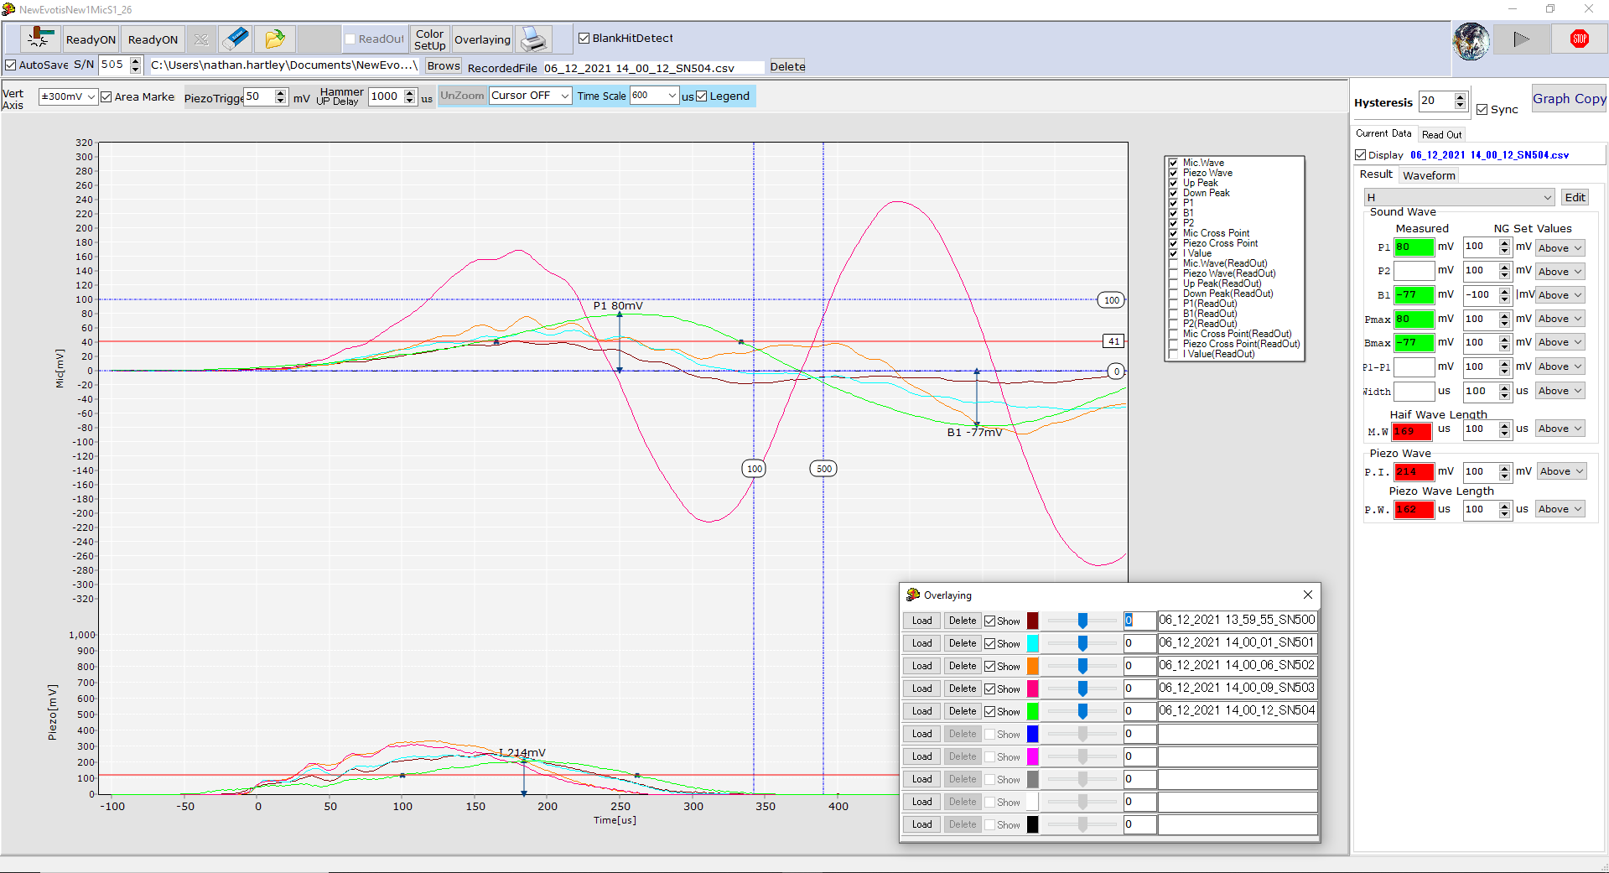

New EVOTIS Tap Testing Device
Market review revealed the New EVOTIS Advanced Tap Tester
Acquires data from both audible response and piezoelectric contact time
Software allows point measurements
to be compared
Examination possibility within noisy environments
Used extensively by Japanese Rail
to inspect their infrastructure
Device provided by J R Technologies Ltd
xxxx

Slide 4

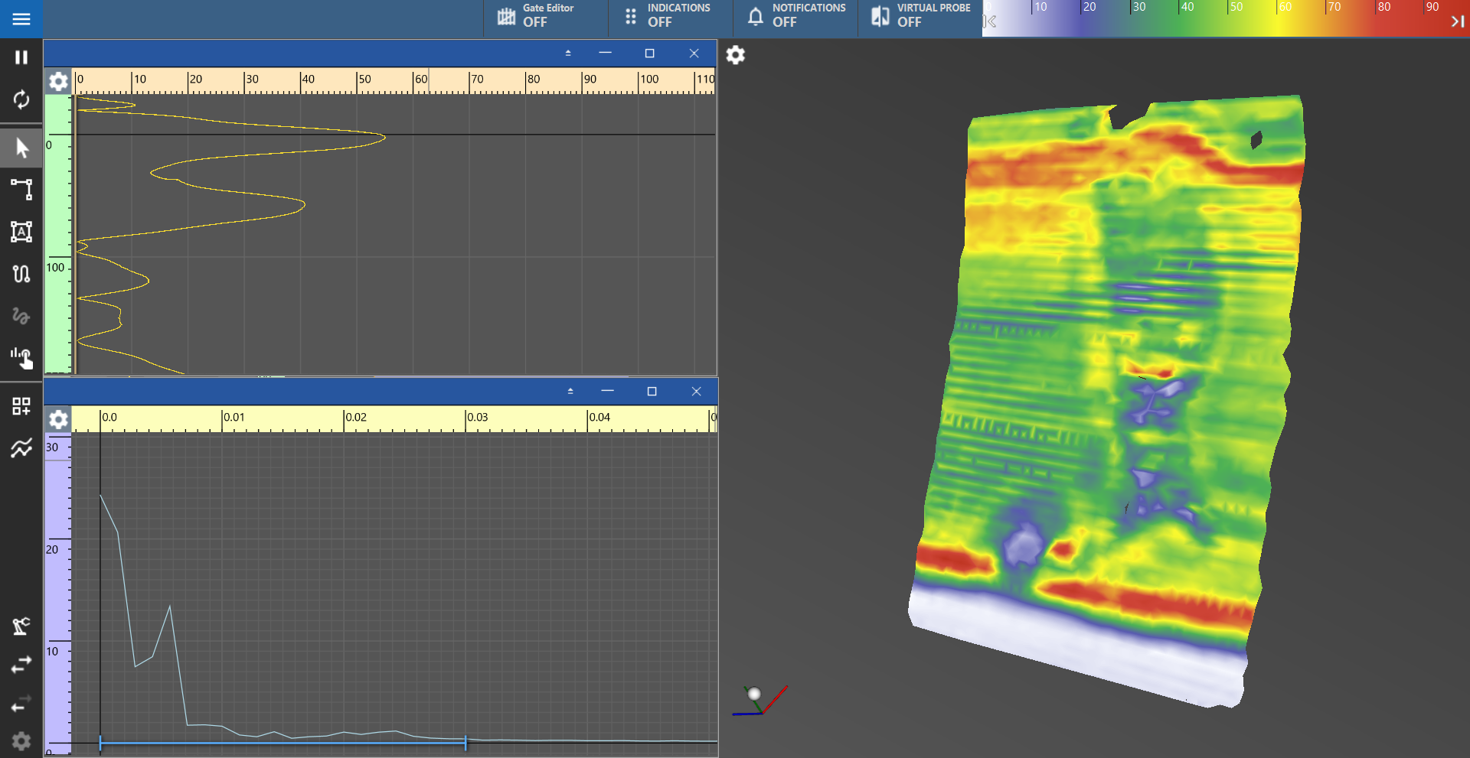
TWI Crystal® Tap Testing Software
Bespoke software developed to plot recorded data as a 2D/3D surface (applicable to CAD model)
Custom signal processing enabled for enhanced analysis methods
Removes operator subjectivity from data analysis
Digital record of results
Software compatible with other NDT methods (UT, PAUT, etc.)
Microphone A-scan
FFT of A-scan
3D mesh surface

Slide 5
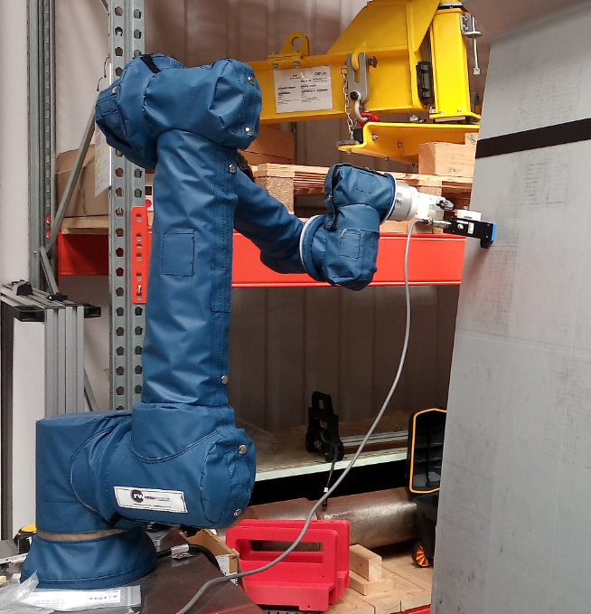
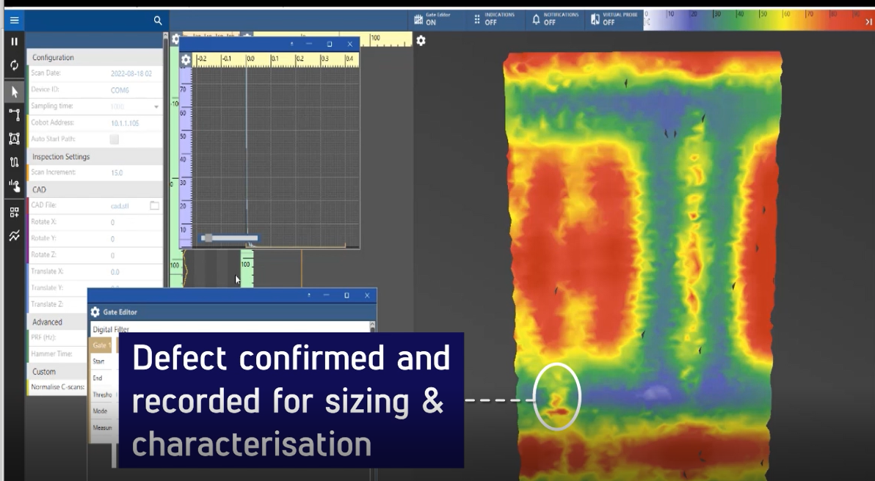
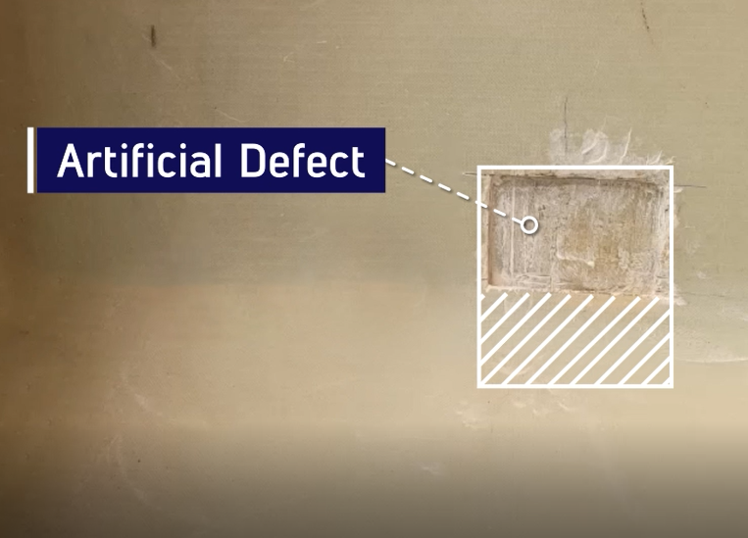
TWI Automated Tap Testing System
Tap Tester
UR Cobot

Slide 6
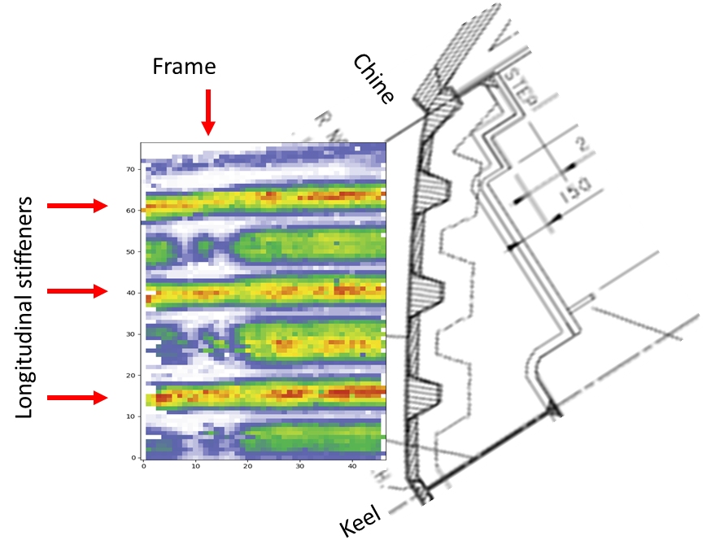
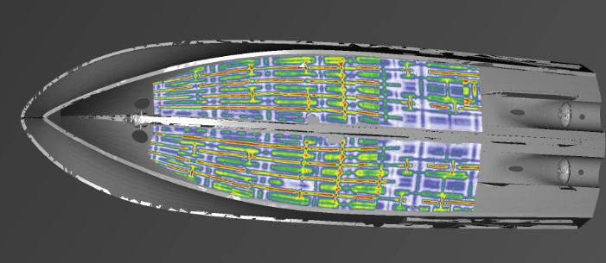
Results: Thick GFRP structures
Purpose to detect indications of stiffener delamination, voids, and other anomalies from the outer composite skin
Large surface area of highly attenuative material: poor UT SNR
Plotting amplitude of
frequency response provided
a good indication of local
stiffness
Note: Colours depict variations in local stiffness, not necessarily flaws or defects ​

Slide 7
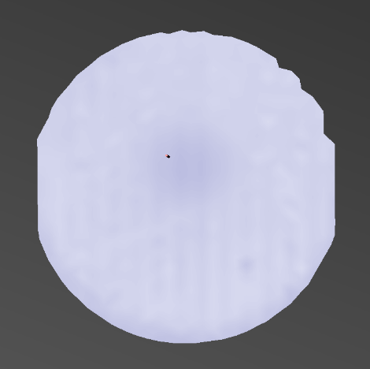
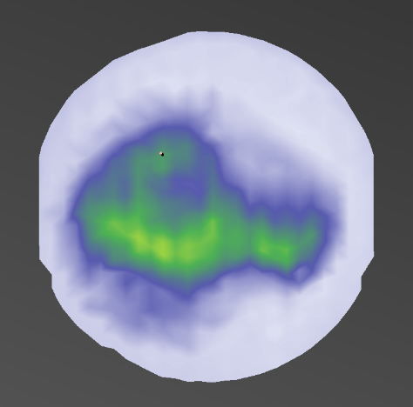
Results: Electrostatic Chucks
Voids suspected in bonding interface between the dielectric layer and the metallic base
Results compared between flaw-free sample and suspected flawed sample
Flawed sample results showed higher amplitude and contained a wider range of frequencies compared to flaw-free sample
TWI’s automated tap test system implemented in ESC production line as a quality controller
Flaw-free ESC
Flawed ESC

Slide 8
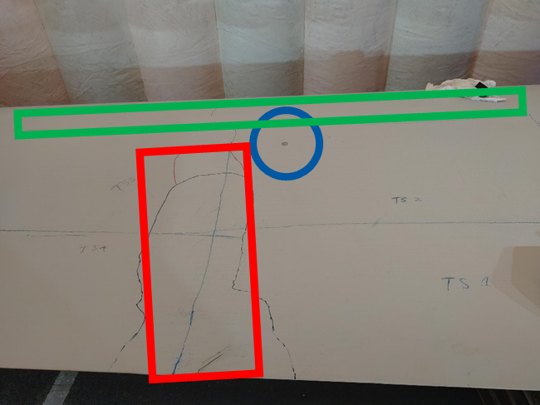
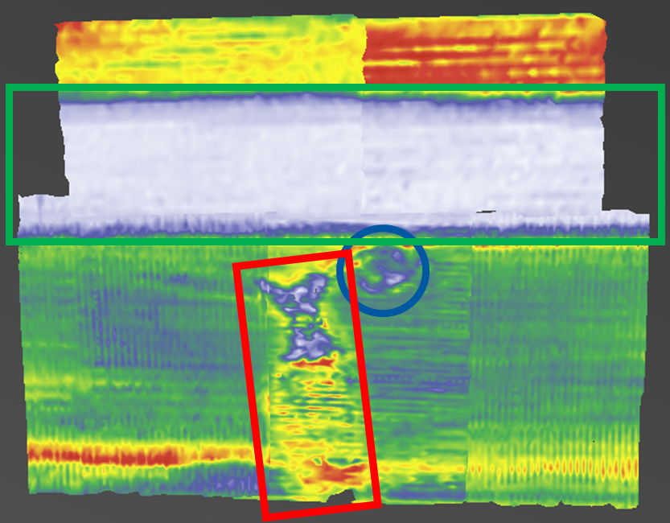
Results: Wind turbine blade
V90 wind turbine blade was grounded and scanned to confirm presence of damage beyond visible areas
Crystal’s in-built path planning conformed to the blade’s complex shape
Following areas identified:
  Red box highlights the extent of damage invisible from the outside
  Green box highlights the spar of the blade
  Blue circle highlights the metal bolt and surrounding resin

Slide 9
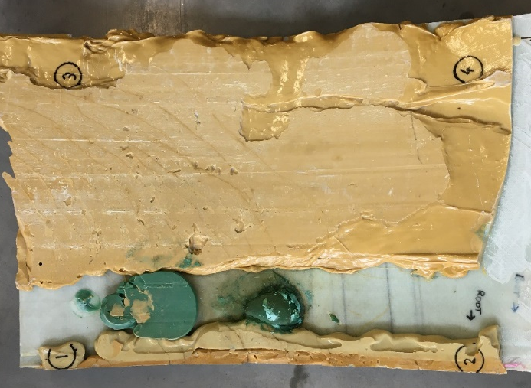
Future Development
Data analysis via algorithmic clustering for enhanced identification and localisation of material discontinuities
Development of a new tap tester with a faster acquisition rate and variable hammer strength
Growth and research within industry:
  Aerospace: BVD detection within wing and fuselage sections
  Oil & Gas: GRE pipes and pipe repairs
  Manufacturing: quality checking of parts
Clustering of tap test data for voids in bonding within wind turbine blade

Slide 10


Questions
Copyright © TWI Ltd 2025
For over 100 years, our customers
have trusted us to deliver...

